Slide 1

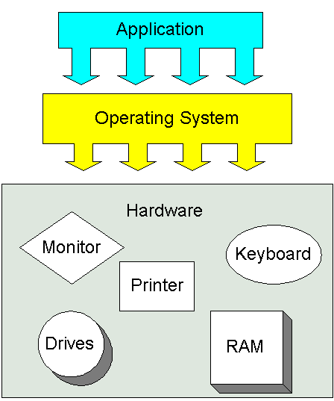
What is operating system
A system software that manages computer hardware and software resources and provides common services for computer programs

Slide 2
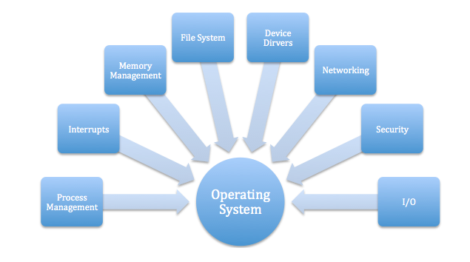
Why we need operating system

Slide 3
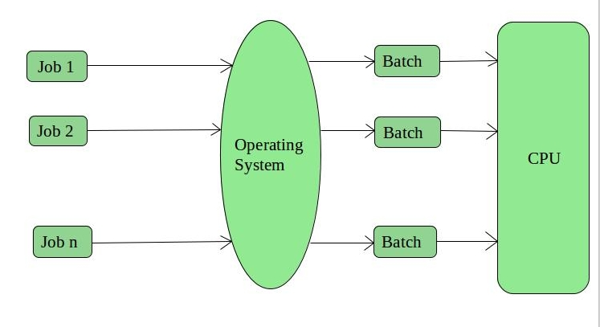
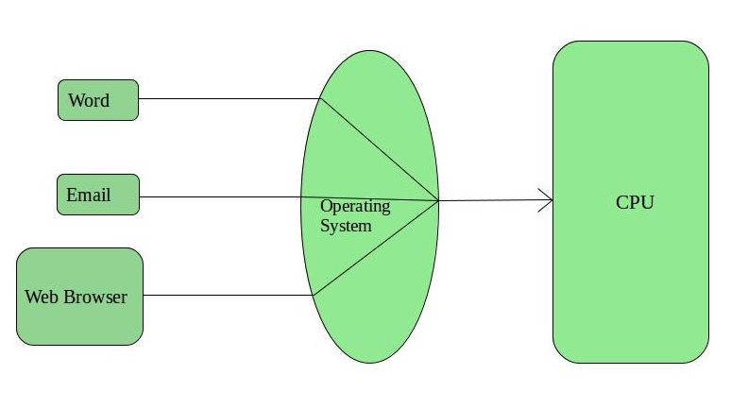
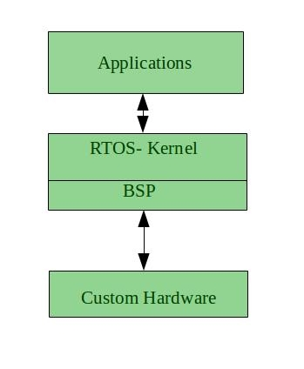
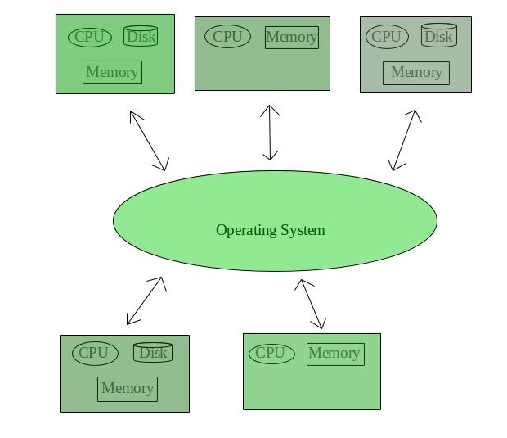
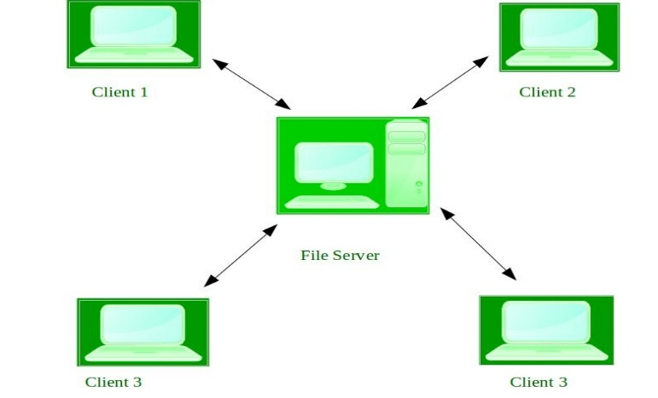
Types of Operating Systems
1. Batch Operating System
2. Time-Sharing Operating Systems
5. Real-Time Operating System
4. Network Operating System
3. Distributed Operating System

Slide 4

Windows operating system
Windows is an operating system designed by Microsoft. The operating system is what allows you to use a computer. Windows comes preloaded on most new personal computers (PCs), which helps to make it the most popular operating system in the world.

Slide 5

Not strong enough for high security.
Are buggy.
Windows series are big.
Windows ME and earlier 9x versions are unstable and insecure.
Source codes of Windows are closed, owned by Microsoft
Wide spread.
Not very expensive.
Supported by most popular softwares.
Windows NT series after 2004 are stabler and securer.

Slide 6
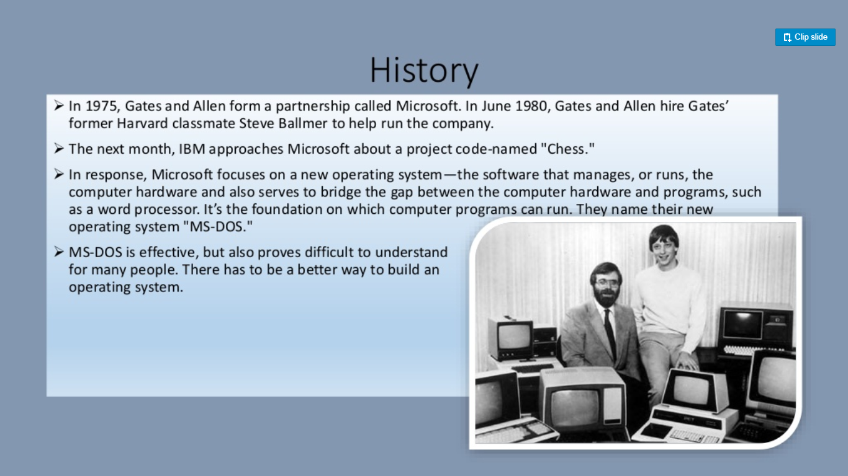

Slide 7
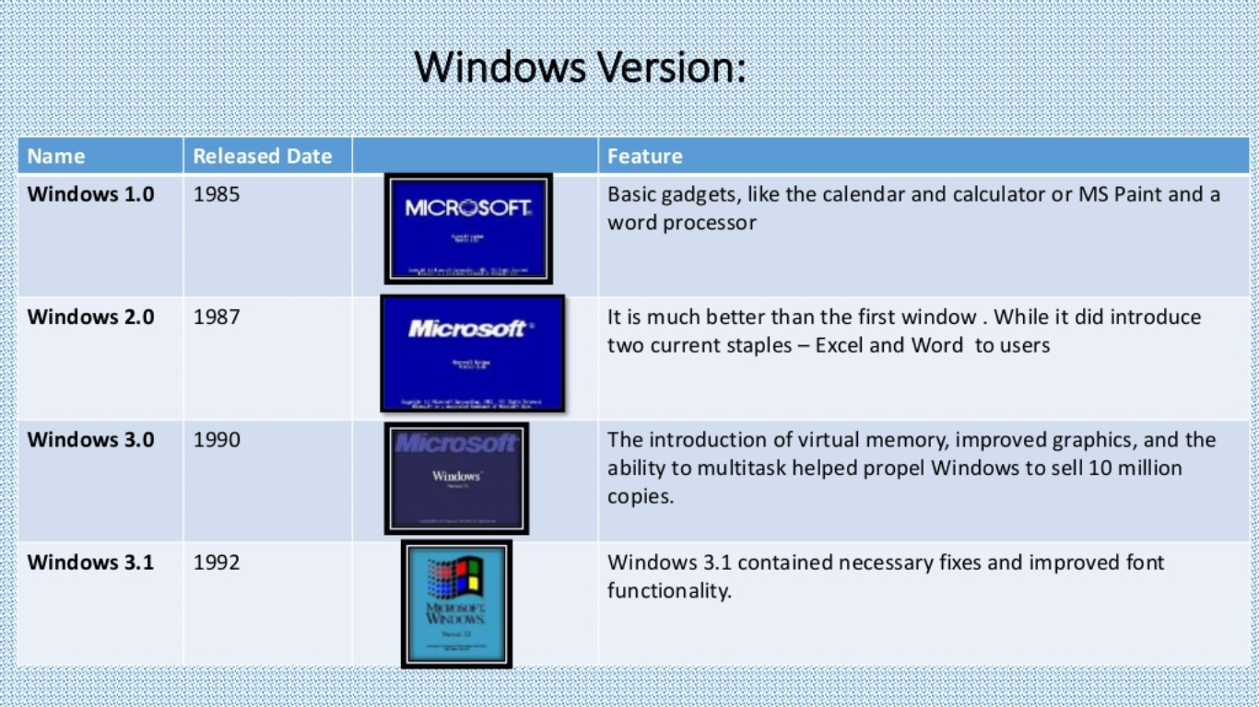
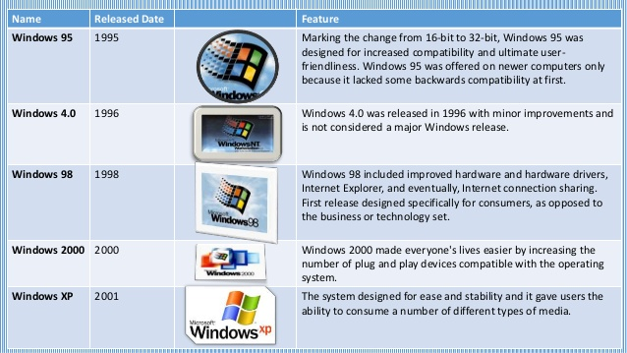
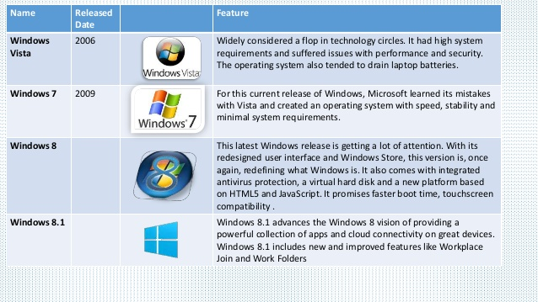

Slide 8
Windows Server 2012 System Requirements
Component | Minimum Requirement | Recommended | Maximum
Processor | 1.4GHZ 64-bit | 2GHZ or faster dual core | Not applicable
Memory | 512MB RAM | 2GB RAM or greater | 32GB RAM Standard Edition4TB RAM Datacenter Edition
Disk space | 32GB | 40GB Full installation or 10GB Server Core installation | Not applicable

Slide 9
Management Mechanism
The registry
Three fundamental mechanisms in Microsoft Windows that are critical to the management and configuration of the system
Services
Windows Management Instrumentation

Slide 10
REGISTRY
The registry is a hierarchical database.
Kernel, device drivers, services, Security Accounts Manager , and user interface can all use the registry.
Used to- Stores low-level settings for the Microsoft Windows operating system and for applications that opt to use the registry.
Example
When a program is installed, a new subkey containing settings such as a program's location, its version, and how to start the program, are all added to the Windows Registry.

Slide 11
STRUCTURE
Keys and values
Registry keys are container objects similar to folders. Registry values are non-container objects similar to files.
Hives
Branches of the registry are actually stored in a number of disk files called hives

Slide 12
EDITING
.REG files
Command line editing
Registry editors
PowerShell commands and scripts
Registry Editor allows users to perform the following functions:
Creating, manipulating, renaming^{[17]} and deleting registry keys, subkeys, values and value data
Importing and exporting .REG files, exporting data in the binary hive format
Loading, manipulating and unloading registry hive format files (Windows NT systems only)
Setting permissions based on ACLs (Windows NT systems only)
Bookmarking user-selected registry keys as Favorites
Finding particular strings in key names, value names and value data
Remotely editing the registry on another networked computer
Programs or scripts
Offline editing
COM self-registration

Slide 13
The Services Console "service.msc" in the Control Panel.
The Services Console allows you to:
List all program services.
View detailed properties of a service.
Change the startup type of a service to: Disabled, Manual, or Automatic.
Start or stop a service.

Slide 14
Examples of Windows Services
Active Directory Service
Computer Browser Service
Prefetch and Superfetch Service
Internet Connection Sharing (ICS) Service
Background Intelligent Transfer Service
DNS Client Service
Routing and Remote Access Service

Slide 15
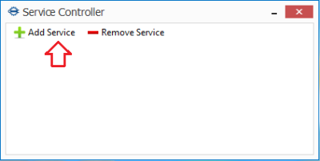
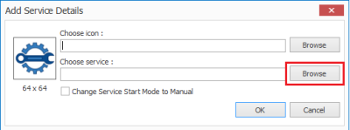
Service Controller
Helps you take some load off the system when the OS initializes.
Minimizes the process involved while controlling Windows Services.
The program lets you manage (start, stop, restart) them in single click.
When asked to browse, select the service you would like to manage via Service Controller.
A list of the Windows Services will be shown.

Slide 16
SERVICE CONTROL MANAGER
Its main function is to start all the required services at system startup.
At boot time, SCM is launched by Wininit. Microsoft provides an API that allows developers to write their own Windows services and have them launched by SCM.
The service functions provide an interface for the following tasks performed by the SCM: * Maintaining the database of installed services. * Starting services and driver services either upon system startup or upon demand * Enumerating installed services and driver services. * Maintaining status information for running services and driver services. * Transmitting control requests to running services. * Locking and unlocking the service database.

